Slide 1


CS-446: Information Systems Security
Lecture # 3: One Time Pad (OTP), Pseudorandom Generator (PRG) and Stream Ciphers
Prof. Dr. Sufian Hameed
Department of Computer Science
FAST-NUCES

Slide 2
Symmetric Cryptosystems
Formal Definition:
Cryptosystem is defined over (K,M,C) and a pair of “efficient” algorithms (E, D) s.t.
∀ m∈M, k∈K and c∈C : E(k, m) = c, D(k, E(k, m) ) = m
Efficient means run in polynomial time
E is often randomized.
D is always deterministic.
Notes:
Picture of cipher

Slide 3
One Time Pad (Vernam 1917)
One Time Pad has perfect secrecy (i.e. no CT only attacks)
Based on simple XOR operation
M=C=K={0,1}^{n}
C:= E(k, m) = k ⊕ m
D(k, c) = k ⊕ c
Indeed
D(k, E(k, m)) = D(k, k ⊕ m) = k ⊕ (k ⊕ m) = (k ⊕ k) ⊕ m
= 0 ⊕ m = m
One-time pad = XOR cipher with constraints:
Key length equals message length
Key bits are truly random (not pseudo-random)
Key is used only once and destroyed
msg: 0 1 1 0 1 1 1
key: 1 0 1 1 0 1 0
CT: 1 1 0 1 1 0 1
⊕

Slide 4
You are given a message (m) and its OTP encryption (c).
Can you compute the OTP key from m and c ?
No, I cannot compute the key.
Yes, the key is k = m ⊕ c.
I can only compute half the bits of the key.
Yes, the key is k = m ⊕ m.

Slide 5
The One Time Pad (Vernam 1917)
Very fast enc/dec !!
… but long keys (as long as plaintext)
Is the OTP secure? What is a secure cipher?

Slide 6
What is a secure cipher?
Attacker’s abilities: CT only attack (for now)
Possible security requirements:
attempt #1: attacker cannot recover secret key
attempt #2: attacker cannot recover all of plaintext
Shannon’s idea:
CT should reveal no “info” about PT

Slide 7
Information Theoretic Security
Basic Idea: CT should reveal no “info” about PT
Def: A cipher (E,D) over (K,M,C) has perfect secrecy if
∀m₀, m₁ ∈M ( |m₀| = |m₁| ) and ∀c∈C
Pr[ E(k,m₀)=c ] = Pr[ E(k,m₁)=c ] where k ⟵K
Given CT can’t tell if msg is m0 or m1 ( for all m0, m1)
Most powerful adversary learns nothing about PT from CT
no CT only attacks !!! (but other attacks possible)
R
Notes:
Explain impications

Slide 8
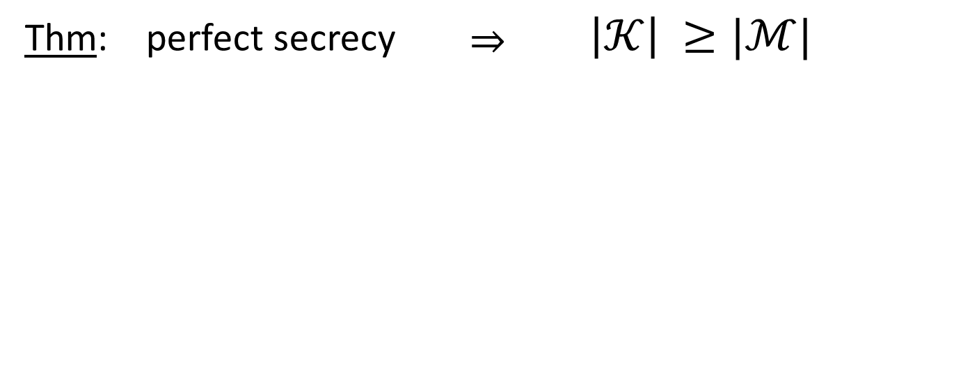
The bad news …
i.e. perfect secrecy ➔ key-len >= msg-len
Hard to use in practice !!!

Slide 9
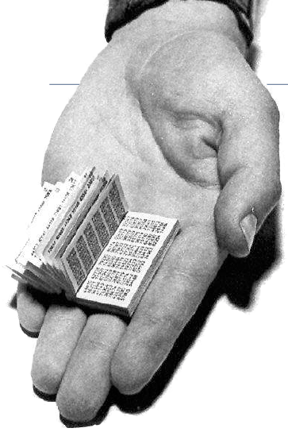
One Time Pad in practice
Intelligence and military services
Regular usage by KGB spies
Hotline between USA and USSR
Major problems
Key exchange difficult
True randomness required
Not very practical today
Inspiration for other methods,
e.g. stream ciphers

Slide 10
Stream Cipher: Pseudorandom Generators

Slide 11
Stream Ciphers: making OTP practical
Idea: replace “random” key by “pseudorandom” key
PRG is a Function G: {0,1}^{s} ⟶ {0,1}^{n}
s.t n >> s
PRG is efficiently computable by a deterministic algorithm
Notes:
The PRNG-generated sequence is not truly random, because it is completely determined by a relatively small set of initial values, called the PRNG's seed (which may include truly random values)

Slide 12
Stream Ciphers: making OTP practical
Key (K) is the seed used by G to generate the PRG
Security: PRG must be unpredictable
Notes:
Define stream cipher

Slide 13
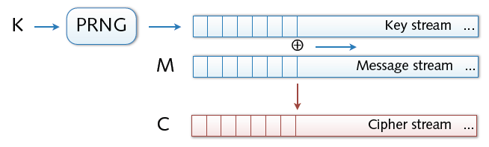
Stream Ciphers
Stream ciphers
Bit-wise encryption and decryption of data
Application of pseudo-random number generator (PRG)
XOR operation on pseudo-random keystream
Security solely depends on randomness of PRG

Slide 14
Stream Ciphers
Stream ciphers cannot have perfect secrecy !!
Need a different definition of security
Security will depend on specific PRG
Notes:
No more perfect secrecy

Slide 15
PRG must be unpredictable
Notes:
Suppose that PRG is predictable. This means that there exist some i s.t if I give you first i bits of the stream (from the PRG) there is some algo that can compute the remainder of the bits.
Attacker intercepts a Cipher
He also somehow know the initial part of the plain text M (e.g in SMTP From: the msg startt).
Based on that it can learn the prefix-of the PR sequence and can predict the remainder (if PRG is predictable)

Slide 16
PRG must be unpredictable
We say that G: K ⟶ {0,1}^{n} is predictable if:
Def: PRG is unpredictable if it is not predictable
⇒ ∀i: no “eff” adv. can predict bit (i+1) for “non-neg” ε
Notes:
Probability if I choose a random key
2^30 is 1 billion

Slide 17
Suppose G:K ⟶ {0,1}^{n} is such that for all k: XOR(G(k)) = 1
Is G predictable ??
Yes, given the first bit I can predict the second
No, G is unpredictable
Yes, given the first (n-1) bits I can predict the nth bit
It depends
FAST-NUCES

Slide 18
Weak PRGs (do not use for crypto)
With LCG small number of outputs can be use to predict remaining bits
glibc random():
r[i] ← ( r[i-3] + r[i-31] ) % 2³²
output r[i] >> 1
Notes:
Linear Congrential Generator is not secure
a and b are integers
P is prime

Slide 19
Negligible and non-negligible
In practice: ε
ε non-neg: ε ≥ 1/2³⁰ (likely to happen over 1GB of data)
ε negligible: ε ≤ 1/2⁸⁰ (won’t happen over life of key)

Slide 20
Attacks on OTP and Stream Ciphers

Slide 21
Attack: two time pad is insecure !!
Never use stream cipher key more than once !!
C₁ ← m₁ ⊕ PRG(k)
C₂ ← m₂ ⊕ PRG(k)
Eavesdropper does:
C₁ ⊕ C₂ → m₁ ⊕ m₂
Enough redundancy in English and ASCII encoding that:
m₁ ⊕ m₂ → m₁ , m₂
Notes:
C₁ ⊕ C_{2 the pads} cancel out and m₁ ⊕ m_{2 is left}

Slide 22

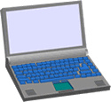
Real world examples
Project Venona (1941-1946)
Roll a dice a compute a pad. This seems boring and they started using the same pads again and again. Soviet messages sent from 1941 to 1946, decrypted about 3000 messages.
MS-PPTP (windows NT):
k
k
Need different keys for C⟶S and S⟶C
Notes:
Venona: Roll a dice a compute a pad. This seems boring and they started using the same pads again and again. soviet messages sent from 1941 to 1946, decrypted about 3000 messages.
MS- Point to Point transfer protocol.

Slide 23
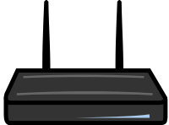
Real world examples
802.11b WEP:
Length of IV: 24 bits
Repeated IV after 2²⁴ ≈ 16M frames
On some 802.11 cards: IV resets to 0 after power cycle
m
CRC(m)
k
PRG( IV ll k )
k
IV
ciphetext
Notes:
Another example of two time pad
A very good example of how not to do
client and AP shared a Key
In order to change the key they appended it with IV. IV is incremented by one for each frame
The design realized that in stream cipher a Key must be used to encrypt one message so they design to change the key for every single frame.
IV changes and Key never changes
So Essentially the IV will be used again and it becomes 2 time pad

Slide 24
Avoid related keys
802.11b WEP:
key for frame #1: (1 II k)
key for frame #2: (2 II k)
m
CRC(m)
k
PRG( IV II k )
k
IV
ciphetext
⋮
Notes:
FMS -→ florain martin and shamir
Within minutes you can recover the key for any WEP network
Here the keys are so much related that the keys can be recovered by just using few cipher texts
What the designers should have done ? Listen to the talk again

Slide 25
A better construction
k
PRG
k
⇒ now each frame has a pseudorandom key
better solution: use stronger encryption method (as in WPA2)

Slide 26
Two time pad: summary
Never use stream cipher key more than once !!
Network traffic: negotiate new key for every session (e.g. TLS)
Disk encryption: typically do not use a stream cipher

Slide 27
Attack 2: No Integrity (OTP is malleable)
enc ( ⊕k )
m
m⊕k
⊕
p
dec ( ⊕k )
m⊕p
(m⊕k)⊕p
Modifications to ciphertext are undetected and have predictable impact on plaintext
Notes:
If you modify the cipher text the changes are undetected. Whatever you add to the cipher text will have the same predictable effect on the decrypted message

Slide 28
Attack 2: No Integrity
enc ( ⊕k )
From: Bob
From: Bob
⊕
⋯
dec ( ⊕k )
From: Eve
From: Eve
Modifications to ciphertext are undetected and have predictable impact on plaintext
Notes:
Bob: 42 6F 62 , Eve: 45 76 65 , Bob ⊕ Eve: 07 19 07

Slide 29
Real-world Stream Ciphers

Slide 30
RC4 Cipher
Common stream cipher
Developed by Ron Rivest for RSA Security
Leaked to the public in 1994 (ARC4 = Alleged RC4)
Key size (seed): 40 to 256 bits
Some known weaknesses, e.g., in WEP implementation

Slide 31

Old example (software): RC4 (1987)
2048 bits
128 bits
1 byte
per round
seed
Used in HTTPS and WEP
Weaknesses:
Bias in initial output: Pr[ 2nd byte = 0 ] = 2/256
Prob. of (0,0) is 1/256² + 1/256³ (happens in GBs of Data)
Related key attacks
Notes:
According to Dan Boneh RC4 should not be used any more
Extends 128 bits to 2048 bits are used as internal state for the generator. Run a Fairly simple loop and output 1 Byte of out as long as required.
If RC4 is random then 2nd byte’s probability to be 0 is double. This means that there is no encryption at 2nd byte
Since first 2 bytes output are bias. It is recommended to start using from 257 bytes
If you observer the very long set of RC4 it turns out that the probability of any two consecutive bytes (0,0) is more often

Slide 32
Old example (hardware): CSS (badly broken)
Linear feedback shift register (LFSR):
DVD encryption (CSS): 2 LFSRs
GSM encryption (A5/1,2): 3 LFSRs
Bluetooth (E0): 4 LFSRs
all broken
Notes:
This is what hardware designer likes. Easy to implement in the hardware.
There are taps at certain position and they are feed into the Xor and that become an input to the register on clock cycle and the right side the bit is resulted in output.
Implemented in hardware so hard to change

Slide 33
Old example (hardware): CSS (badly broken)
CSS: seed = 5 bytes = 40 bits
Notes:
Seed was limited to 40 bits, 5 bytes. Reason to limit was at that time US Export regulation only allow export of systems with 40 bits encryption.
LFSR run for 8 cycles. They generate 8 bits of output. They are input to a adder (addition modulo 256).
The 8 bit (1 byte output from the adder) is encrypted with the movie data.

Slide 34
Cryptanalysis of CSS (2¹⁷ time attack)
17-bit LFSR
8
encrypted movie
+ (mod 256)
8
⊕
prefix
25-bit LFSR
8
CSS prefix
For all possible initial settings of 17-bit LFSR do:
Run 17-bit LFSR to get 20 bytes of output
Subtract from CSS prefix ⇒ candidate 20 bytes output of 25-bit LFSR
If consistent with 25-bit LFSR, found correct initial settings of both
Using key, generate entire CSS output
Notes:
Movies are Mpeg file so you know the Initial Prefix of the Movie and can generate the CSS prefix (PRG).
Let suppose that the prefix in 20bytes

Slide 35
Modern stream ciphers: eStream (2008)
PRG: {0,1}^{s} × R ⟶ {0,1}^{n}
Nonce: a non-repeating value for a given key.
E(k, m ; r) = m ⊕ PRG(k ; r)
The pair (k,r) is never used more than once.
Notes:
Parameters are different. Seed and Nounce
You can reuse the key. Since the nonce makes the pair unique.
This saves the trouble of moving to a new key every time.
Estream project called for improvement. 5 finalist and and we will discuss just one example

Slide 36
eStream: Salsa 20 (SW+HW)
Salsa20: {0,1} ¹²⁸ ^{or 256} × {0,1}⁶⁴ ⟶ {0,1}^{n}
Salsa20( k ; r) := H( k , (r, 0)) ll H( k , (r, 1)) ll …
0,1… are counters that goes from step to step
h: invertible function. designed to be fast on x86
τ₀ k τ₁ r i τ₂ k τ₃
kr
i
⊕
64 byte
output
h
(10 rounds)
32 bytes
64 bytes
64 bytes
Notes:
H takes key, nonce and counter
Xor is actually word-wise addition. τ_{i} fixed constant of 4 bytes, K = 16 bytes, r = 8 bytes, i =8bytes).
Easy to implement both is software and hardware.
What seems to be XOR is actually Addition to add randomness. Small h is completely invertible one-to-one function

Slide 37
Is Salsa20 secure (unpredictable) ?
Unknown: no known provably secure PRGs
In reality: no known attacks better than exhaustive search

Slide 38
Performance:
AMD Opteron, 2.2 GHz ( Linux)
PRG Speed (MB/sec)
RC4 126
Salsa20/12 643
Sosemanuk 727
eStream

Slide 39
Acknowledgements
Material in this lecture are taken from the slides prepared by:
Prof. Dr. Konrad Rieck (Uni-Göttingen)
Prof. Dan Boneh (Stanford)

